Slide 1

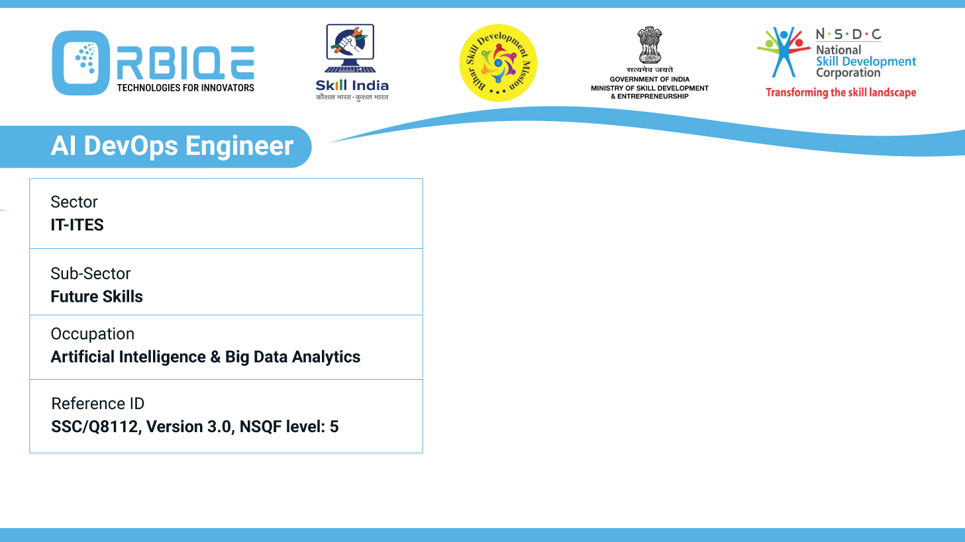
Name- Krishna Kant Dubey

Slide 2

Principles of Master-Agent Architecture in Configuration Management

Slide 3
Agenda
The master server centrally manages configurations and distributes them to agent nodes.
Allows for the efficient management of large-scale infrastructure by distributing workload among agents
Ensures secure communication between master and agent nodes for configuration updates
Supports dynamic configuration changes and updates across distributed systems

Slide 4
The master server centrally manages configurations and distributes them to agent nodes

Slide 5
Allows for the efficient management of large-scale infrastructure by distributing workload among agents

Slide 6
Ensures secure communication between master and agent nodes for configuration updates

Slide 7
Supports dynamic configuration changes and updates across distributed systems

Slide 8
Thank You

